Slide 1
Wel come

Slide 2
Algorithm Design & Analysis
Merge Sort
Presentation By : Praveen Kumar

Slide 3
Merge sort
Merge sort is a sorting technique based on divide and conquer technique. With worst case time complexity being Ο(n log n), it is one of the most respected algorithms.
Merge sort first divides the array into equal halves and then combines them in a sorted manner.

Slide 4
Divide And Conquer
Divide : Divide the unsorted list into two sub lists of about half the size.
Conquer : Sort each of the two sub lists recursively until we have list sizes of length 1,in which case the list itself is returned.
Combine: Merge the two-sorted sub lists back into one sorted list.

Slide 5
Merge Sort Example
25 | 65 | 31 | 5 | 84 | 12 | 15 | 89
25 | 65 | 31 | 5
84 | 12 | 15 | 89
25 | 65
31 | 5
84 | 12
15 | 89
25
65
31
5
84
12
89
15

Slide 6
Merge Sort Example
SORT (int Array,int l,int r)
{
if (l < r )
{
then m= (l+ r) / 2 ]
SORT(Array,f,m)
SORT(Array,m + 1,r)
MERGE(Array,f,m,r)
}
}

Slide 7
Merge (int Array[ ],int l,int r,int m)
{
// Find sizes of Two Arrays
Int n1=m-l+1;
Int n2=r-m;
//create temp Arrays
Int LA[ ]=new int[n1];
Int RA[ ]=new int [n2];
//Copy data to temp Array
For(int i=0;i<=n1;i++)
{
L[i]=arr[1+i];
}
For(int j=0; j<=n2; j++)
{
R[i]=arr[m+1+j];
}

Slide 8
//merge two Arrays
Int i=0;j=0;
Int k=1;
While(i<=n1&&j<=n2) {
If(L[i]<=r[i]) {
Arr[k]=L[i];
i++;
K++; }
Else {
Arr[k]=L[i];
i++;
K++; } }
Else {
Arr[k]=L[i];
i++;
K++; }
Copy remaining elments
of L[ ] if any
While(i<n1){
Arr[k]=L[i];
J++;
K++;}
Copy remaining elements
of R[ ]if any
While(j<n2){
Arr[k]=R[i];
}
}

Slide 9
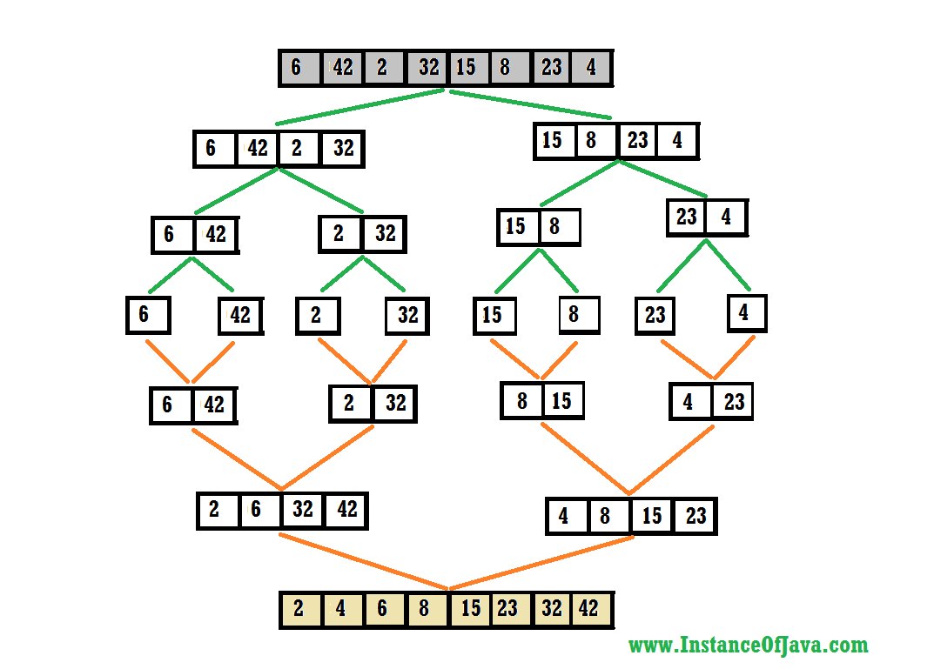

Slide 10
THANK YOU

Slide 11
Any Queries
?

